Slide 1


Graphics
Images within 2D games
Part 1 – Using Images

Slide 2
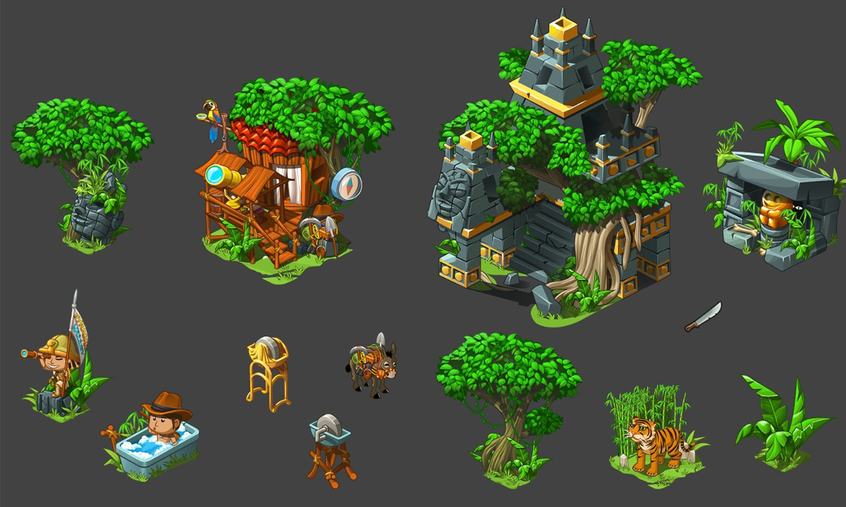
The Role of Images within Games

Slide 3


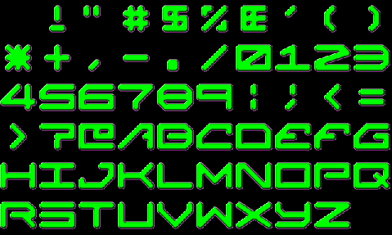

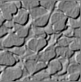


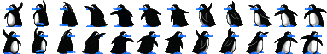
Images play many roles within 2d games, including:
Game objects
Character sheets
Background & decoration
Special effects
UI/HUD elements
Animations

Slide 4
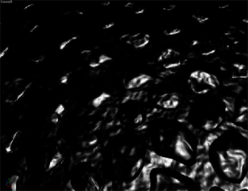
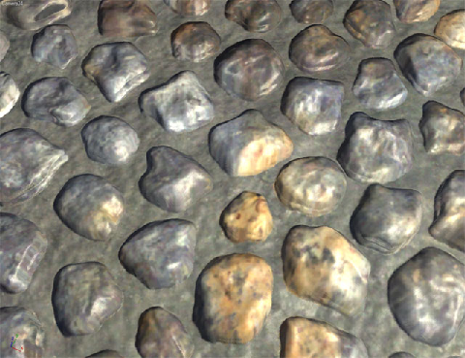
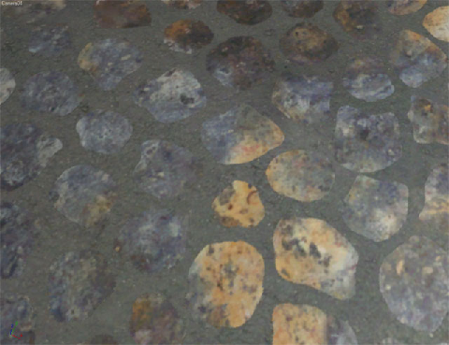
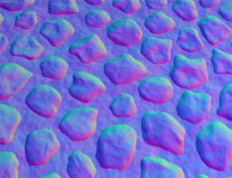
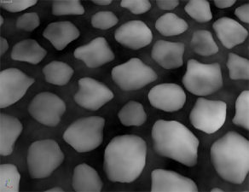
Aside: Images also play a key role in 3D games in terms of how a surface is rendered.
Specular
Normal
Diffuse
Height
The roles of image include (but are not limited to): diffuse, specular, normal, height, emissive maps etc.

Slide 5

Image Characteristics

Slide 6
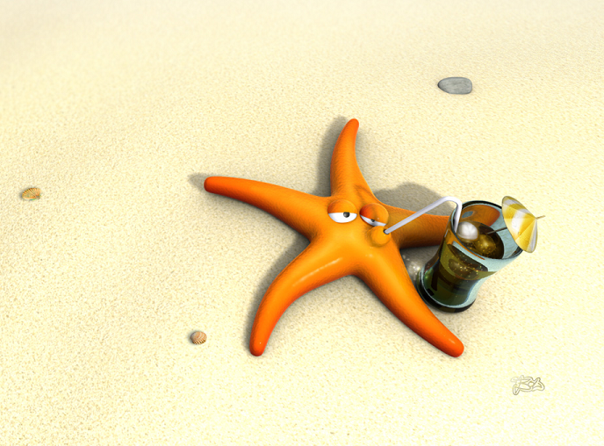
An image can be defined in terms of:
Type (e.g. bitmap, vector)
Dimension (pixel width and height)
Channels
Colour depth (8/16/24 bits per channel etc.)
Compression type
Bitmap, 768x512 pixel image
Four channels (red, green, blue, alpha)
8-bits per channel (32 bits/pixel)

Slide 7
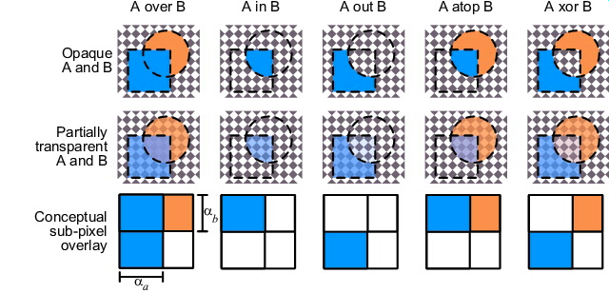
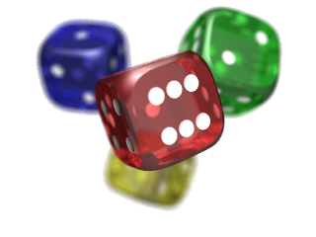
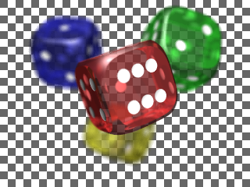

: Alpha Channel
● If an image does not have an alpha channel it is opaque
● Images with an alpha channel may be either transparent or translucent.
Opaque
Transparent
Translucent
Aside: Combining a transparent or translucent image with another image is a process known as compositing.

Slide 8
: Common Image Types
There are lots of different image formats. Four of the most common are BMP, JPG, GIF and PNG.
Format | Compression | Colour depth | Transparency | Translucency
BMP | None/Poor | 1,2,4,…,32 | Separate file | Separate file
JPG | Lossy/Good | 8,12,24 | No | No
GIF | Poor(ish) | 1,2,3,4,…,8 | Yes | No
PNG | Lossless, Good | 1,2,4,…,64 | Yes | Yes
Suggestion: For hassle free development, store your graphics in PNG format.

Slide 9
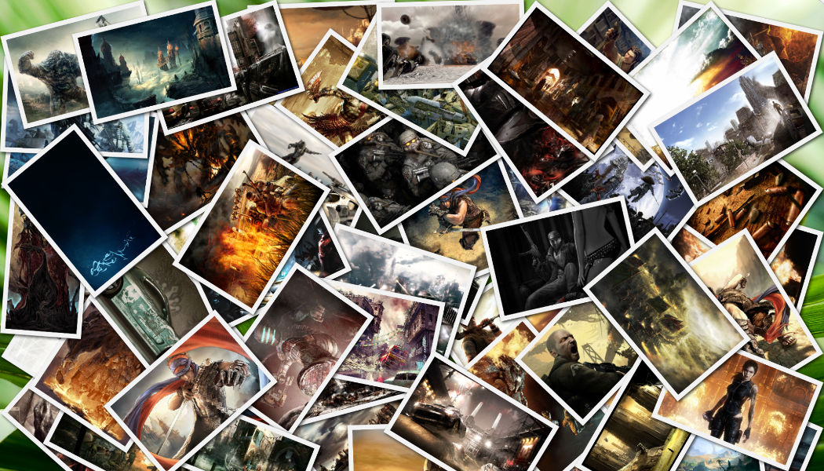
Image Repository

Slide 10


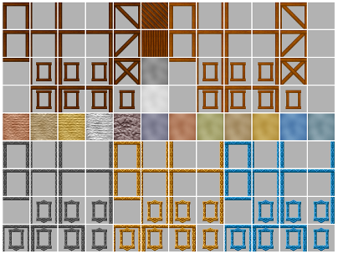
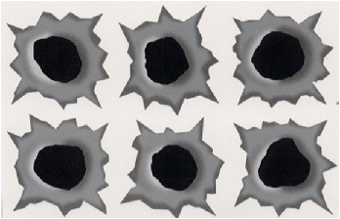


To do:
Explore Images
A repository of images (including GUI/HUD elements, fonts, sprite and tile sheets, animations, etc. is available to help you source graphics for your game. You can also source images from other sources such as Google Images, etc.
Important: Infringing copyright is wrong. It is your responsibility to ensure you have adequate usage permission.

Slide 11
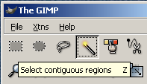
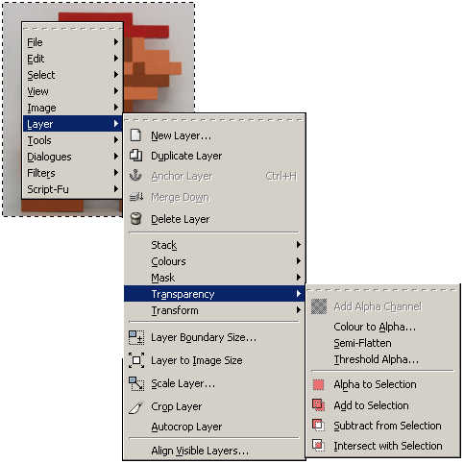
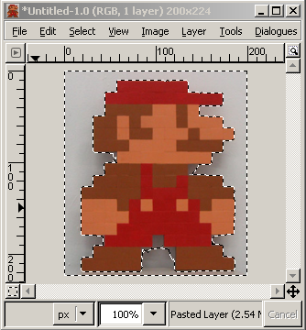
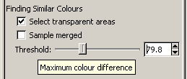
Most popular image editing programs will enable you to make/edit transparent/ translucent images. To do this you may need to make sure the image has an alpha channel. The ‘magic wand’ selection tool can be used to select regions to be cut to reveal the transparent background.

Slide 12

Key takeaways:
You will likely be using lots and lots of images in your game.
Explore the image repository and start building your own collection of images that you could use.

